Slide 1



WELCOME

Slide 2
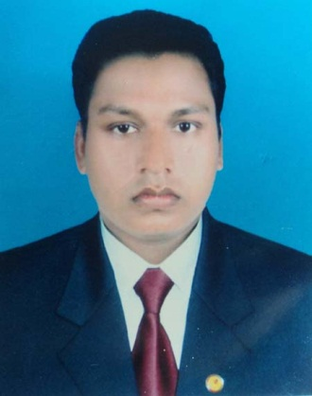
Presnted By
MD: SAIFUL ISLAM (M.A.B.ED)
Asst: Teacher (I.C.T)
Karitola S.H. high school.
Shariyakandi, Bogra.
Mobile no- o1717521943
Email- saifulislam19840102@gmail.com

Slide 3
Class : Six
Subject: English (2nd paper)
Time :45 minite
Dated : 08-02-2016

Slide 4
Learning Outcomes
By the end of the lesson students will be able to:
Learn kind of Tenses
Write sentences in deferent from of present Indefinite Tense
Uses of present Indefinite Tense

Slide 5
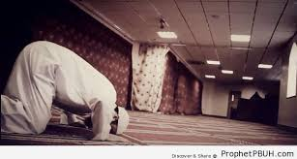
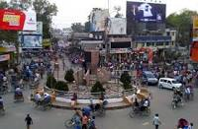
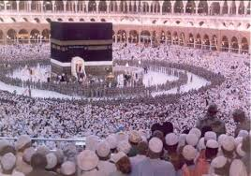
He goes to mosque everyday
You went to Bogra last year
I shall go to Mokka next year.
Here the words written in blue colour indicate time of action .
Tense is the form in which a verb is used to express when an action is , was or will be performed.

Slide 6
Remember it easily
Past
Future
Present

Slide 7

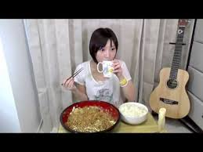
Present indefinite Tense
Habitual fact
Universal truth
Present indefinite Tense means a verb used for habitual fact, universal truth the action that is usal and the action that takes place regularly

Slide 8
Today we will disscuss about:
The use of Present indefinite Tense

Slide 9
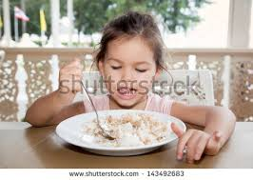
Struture of Present indefinite Tense
Make four sentences from the picture
Subject
Present form of verb
Object
Shinha eats rice
She eats rice.
The girl eats rice.

Slide 10
You have to keep it in your mind that if you see these words in any sentence such as .
Sometimes ,Often , Generally ,Normally , Regularly ,Properly, Hardly, that is Present indefinite Tense .
Example: He hardly comes here.

Slide 11


Pair work
Write three sentenses of present indefinite tense.
Identify which verbs are present indefinite Tenses.
Rahim is a good boy. He goes to school everyday. He says his prayers regularly . He loves his parents.
We add S/es after the base from of verb ,if the subject is third person and singular number.

Slide 12
Evaluation
Fill in the gaps with right from of verbs.
He -----------(play) football everyday.
Rahim -----------(go) to school regularly.
You -------------(say) your prayers daily.

Slide 13
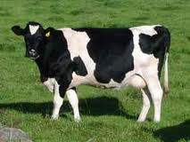
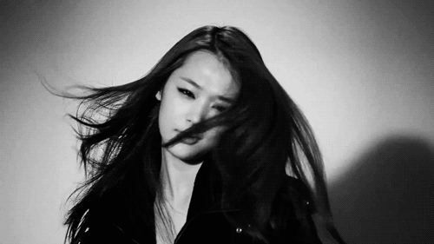
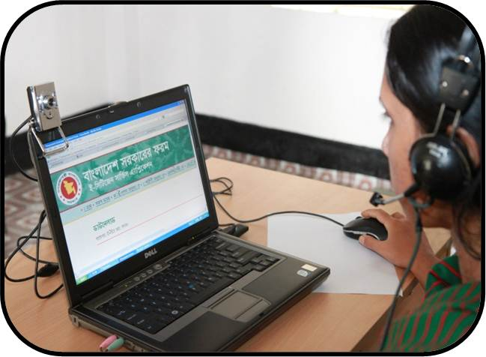
Home work
Use where s/es will be used after the verb or not from the bellow sentences.
The cows live on grass.
Her hair look black.
Our parents love us very much.
He used Doel laptop to make contents

Slide 14

EVERYBODY
THANKS

